Slide 1
SMART LOCATION ALARM

Slide 2
ABOUT OUR APP
Smart Location Alarm is a web application designed to enhance travel experiences by providing real-time notifications when users reach their destinations. Users input their destination and the app tracks their progress using GPS API. It offers notification, integrates with mapping services, and sends alerts as the destination approaches. Overall, Smart Location Alarm simplifies travel and ensures users arrive at their destinations informed and on time..

Slide 3

GOALS & OBJECTIVES
01
The primary goal of ArriveNotify is to enhance the overall travel experience for users by providing them with timely and relevant notifications and alarm as they reach their destinations.
02
To simplify the travel process by eliminating the need for users to constantly monitor their progress or check navigation apps during their journey.
03
To become a reliable companion for travelers, ensuring accurate notifications and smooth functionality to build trust among users.

Slide 4







Stack used

Slide 5
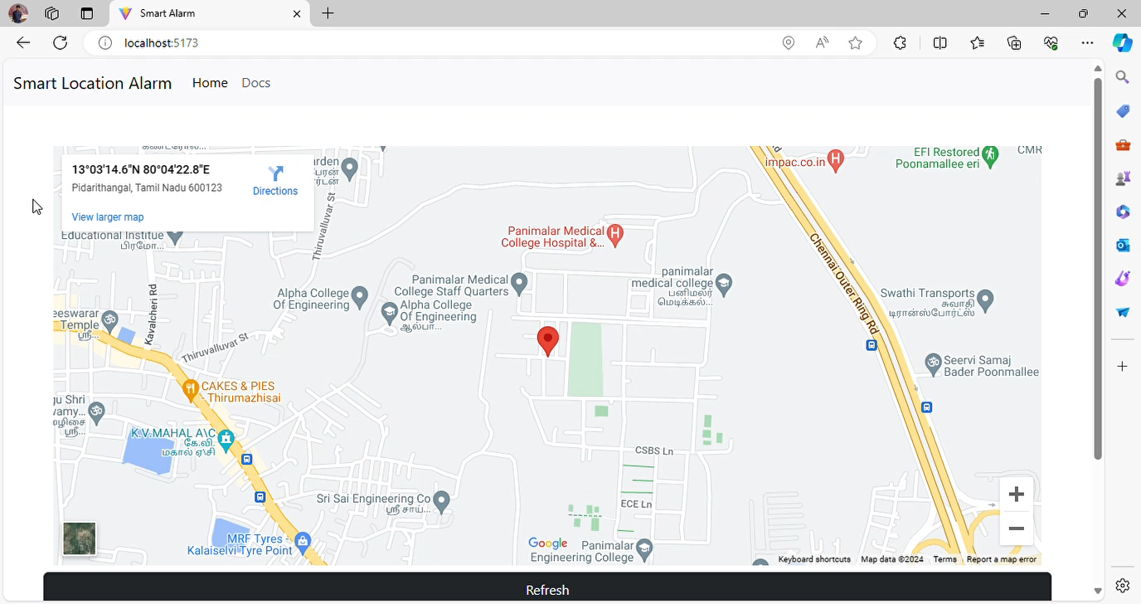

Slide 6
Features
Alert users by sending a notification (SMS) text when user is about to reach the destination
Alert the user by ringing alarm when the destination is reached

Slide 7
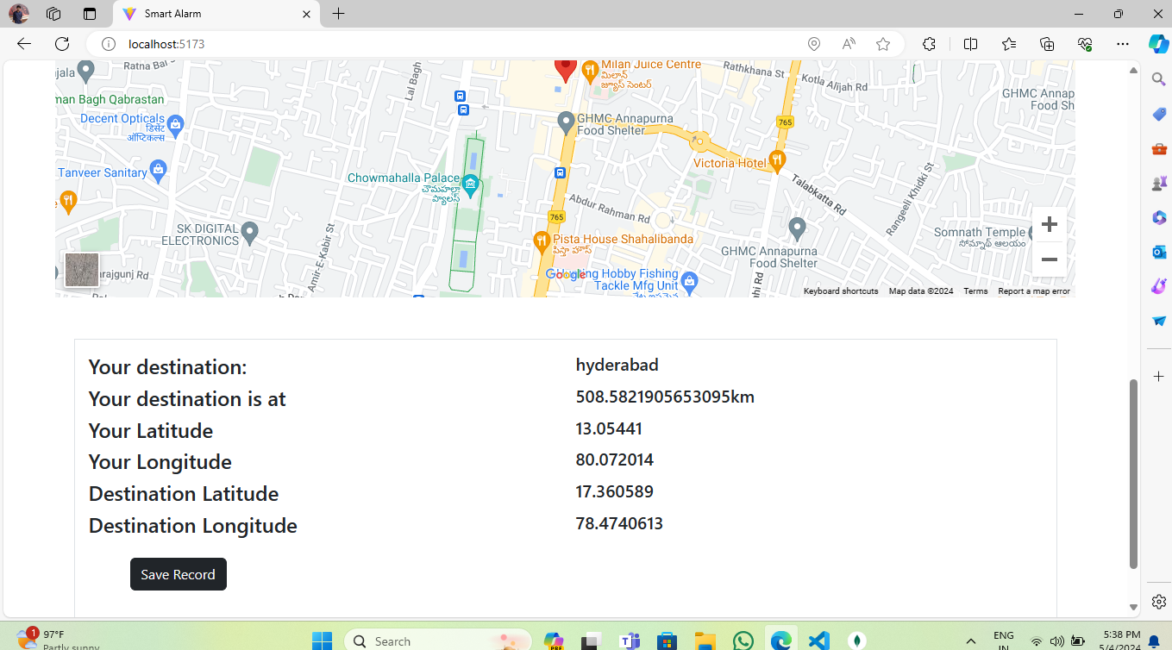
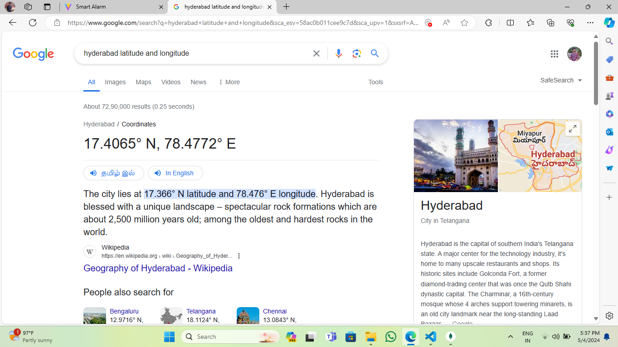
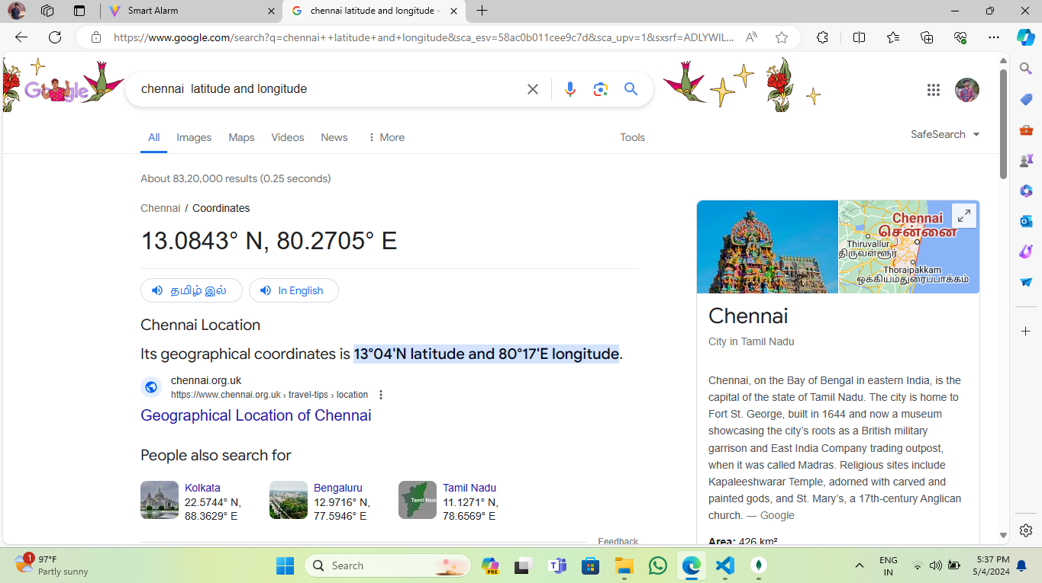

Slide 10


TEAM MATES
Sanjai Kumar R
Kumaran S

Slide 11

TEAM MATES
Santosh Charan R
Tamil Amitraj

Slide 12
THANKS !

